Slide 1

Building a Restful Service
SCRUM Meeting
September 27th, 2026
Notes:
Background: F5F1E8
Text: 2C3E50

Slide 2
Core Challenges
Website
  Website needs to be able to access data and present that data
    How do we send data?
    How do we pick what is relevant to the specific query?

Slide 3
Basic URL Breakdown
Protocol
Domain
Path
Query Parameter

Slide 4
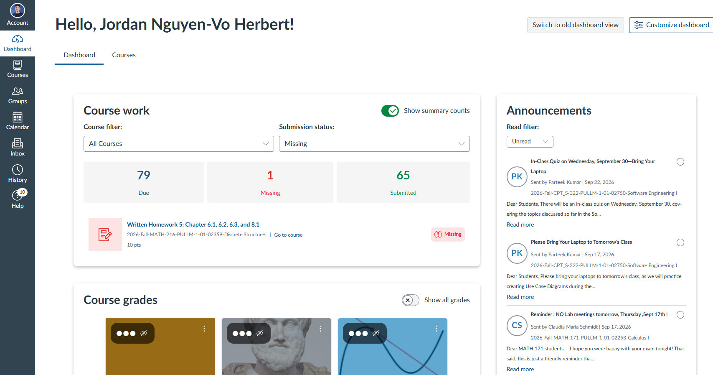
https://
wsu.instructure.com
/courses/1894762
/pages
?module_item_id=26789979

Slide 5
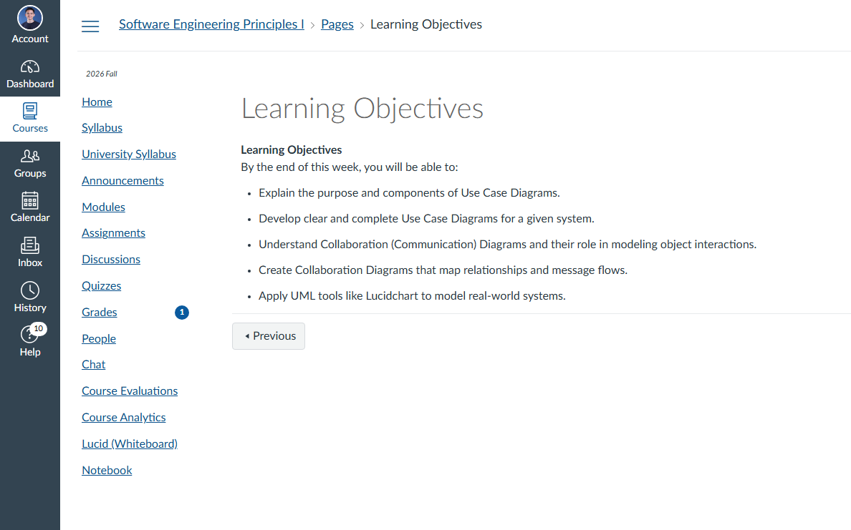
https://wsu.instructure.com/courses/1894762/pages/learning-objectives-5?module_item_id=26789979
https://wsu.instructure.com/courses/1894762/pages/learning-objectives-5?module_item_id=26789979

Slide 6
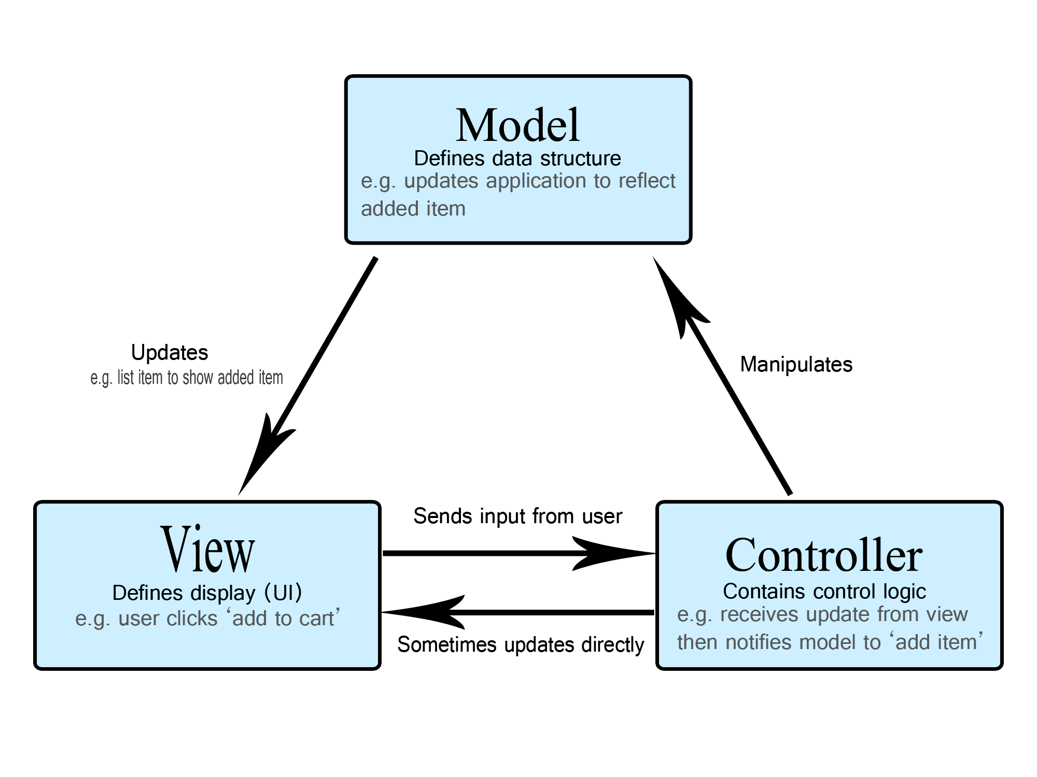

Slide 7
GET Request
Spring
@RestController
@GetMapping(/students/{id})
Clubhub.com/…/students/11983460
Specific instance of Student record found via Controller method
@GetMapping tells Spring this is the method for fulfilling this specific request
@Pathvariable uses value from GET request, which is then used to identify the correct Entity instance and when returning record
JSON

Slide 8
Accessing Data with JPA

Slide 9
How can we access data from different entities?
Java Persistence API
  Creates and stores entity objects
  Removes the need for data base system
Requires the usage of default ghost constructor
  Functions as a placeholder
    Reflection -> allows access to and manipulate object
Student
Long id
String email
String password

Slide 10
@Entity
Student
Long id
String email
String password

Slide 11
Annotation
@Entity
  Indicates that the object is a JPA entity
@Id
  Points to the specific field being used to create a unique instance of the object within the database
@GeneratedValue(strategy=GenerationType.Auto)
  Uses this to auto populate the most appropriate value

Slide 12
@Entity
Student
@ID
@GeneratedValue
Long id
String email
String password

Slide 13
GET Request
Spring
@RestController
@GetMapping(/students/{id})
Clubhub.com/…/students/11983460
Specific instance of Student record found via Controller method
@GetMapping tells Spring this is the method for fulfilling this specific request
Specific entity is retrieved from storage, values are used to populate the record
@Pathvariable uses value from GET request, which is then used to identify the correct Entity instance
JSON

Slide 14
Resources
https://spring.io/guides/gs/rest-service/
https://spring.io/guides/gs/accessing-data-jpa

